Slide 1
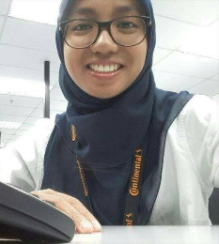
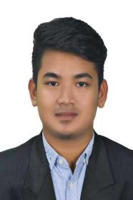
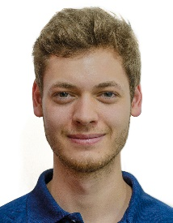
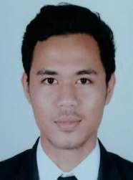
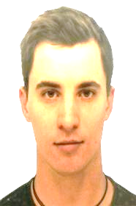
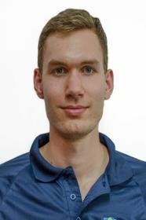
Project Manager
(Nurain Rozy)
Mechanical
Engineer
(Azril Zulkafli)
Software Engineer
(Uli Michael)
Software Engineer
(Syakir Turiman)
Electrical Engineer
(Jacob Kleikamp)
Electrical Engineer
(Lorenz Wilhelm)

